Slide 1

Manual Handling Training
Course 2022
© 2022 UK Health & Safety Officials.

Slide 2
Manual Handling Incidents
Notes:
HSE figures suggest that of all the reportable accidents every year around 36% of them will be manual handling incidents. In the University we tend to have more slips and trips but MH is always a close second.
Of these injuries about half are back injuries and 30% are hand and arm. The non back injuries tend to be crushing or trapping of fingers, or upper limb disorder such as muscle strains or tendonitis.

Slide 3
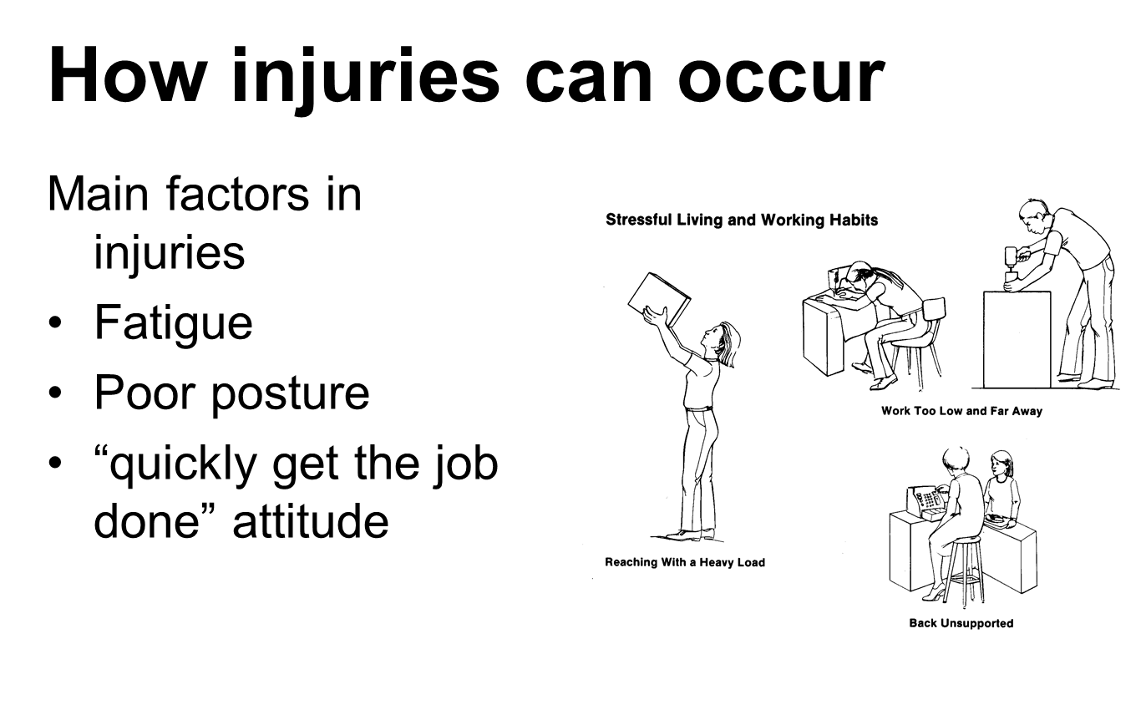
Notes:
Although most of these incidents seem to happen suddenly following a single activity they are more likely to be cumulative injuries resulting from a longer period of poor posture.

Slide 4
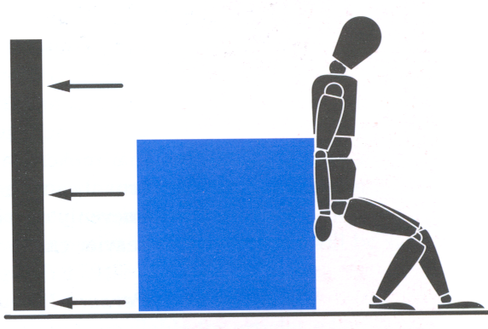
Manual Handling is -
The movement of a load
by human effort either
directly or indirectly
Supporting a load without moving it
Pushing or pulling a load
Intentionally throwing or dropping the load
Notes:
The movement of a load by human effort – as opposed to using a forklift truck or equivalent.
Either directly or indirectly – using the hands or body to move something is direct and tying a rope round something and pulling it is indirectly
A load is a discrete moveable object such as a box or bag of compost. It does not include implements tools or machines when used for their intended purpose. If you are moving a sack truck for the purpose of taking it to a different location it is a load – if it has a load on it that is being moved it is not a load in itself.

Slide 5
Manual Handling Operations Regulations
Employers must
Avoid the need for manual handling where possible
Assess the risk of injury
Reduce the risk as far as is practical
Notes:
Assessments should be reviewed on a regular basis and should take consideration of what is still reasonably practical and what changes in technology may have made more easily available. The assessment should also be reviewed if there is a change in the operations that will alter the previous outcomes or if there is an accident. An assessment does not need to be recorded if the task is simple and can be repeated or explained at any time, or if the operation is of low risk and straightforward while lasting only a short time.

Slide 6
Manual Handling Operations Regulations
Employees must
Follow safe systems of work
Use any equipment provided
Cooperate with employer on H&S matters
Notify of any hazards
Ensure activities don’t put others at risk

Slide 7
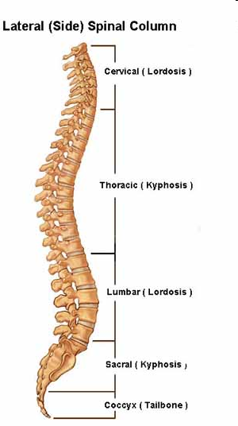
The spine
The spine consists of
Spinal Cord
Vertebrae
Intervertebral discs
Ligaments
Tendons
Muscles
Notes:
Why is the back so vulnerable to injury?
And how can we prevent it?
The spinal cord is a thick cord of nerve tissue which is enclosed by the spine. Together with the brain it forms the central nervous system.
The vertebrae are the bones which act as the building blocks of the spine. They can be damaged by impact injury as with any other bone.
The intervertebral discs are kind of shock absorbers – they are soft fibrous discs with a jelly like centre and are positioned between the vertebrae. They allow the spine to move by cushioning movements between the vertebrae.
When a person sits or stands upright the spine has this S shaped structure – and this allows downward pressure to be exerted evenly over the surfaces of all the discs.

Slide 8
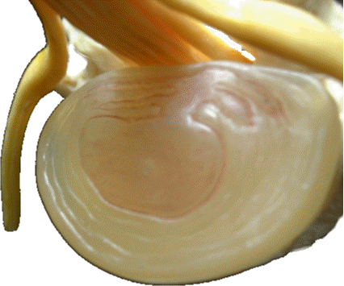
Disc Problems
Notes:
If you bend over at the waist the downward pressure will be uneven with the greater part of the load on the front edge of the disc – this causes the jelly fluid to be pushed towards the back of the disc which adds pressure to the fibres at the back of the disc. Over time if the action is repeated these fibres wear and the fluid form the centre becomes pushed outwards, pressing on the nerves and causing pain.
Obviously this is easy to avoid by correct lifting techniques

Slide 9
Ligaments, tendons and muscles
Ligaments – straps which stretch between bones holding them together
Tendons – the means by which the muscles are attached to the bones
Muscles – provide the main stability for the vertebral column
Cumulative strain - Injury caused by twisting and stretching repetitively
Notes:
Ligaments – gristly straps which stretch between bones holding them together and mainly control the direction of motion and limit movement at the end of the normal range
Tendons – the means by which the muscles are attached to the bones
Muscles – muscles are found in pairs on either side of the spine and provide the main stability for the vertebral column
Ligaments tendons and muscles can be injured as a result of twisting and stretching particularly if carried out repetitively over a period of time. These types of injuries are called soft tissue injuries and tend to be the cause of the majority of reported back injuries. Cumulative strain is when these injuries occur as a result of repetitively carrying out these activities – and is a loss of elasticity in muscle structures until ordinary movement becomes harmful movement.

Slide 10
Other Injuries
Hernias
Fractures
Bruises
Cuts / Lacerations
Notes:
Hernias tend to be associated with manual handling due to the increased pressure in the abdominal cavity when lifting. Especially when bending to lift and the internal organs are compressed, a loop of intestine can be forced out through any weak spots in the abdominal wall, which is a hernia.
In general injuries such as fractures cuts and bruises result not from the action of lifting or moving but from associated issues such as dropping the load or poor housekeeping leading to trips etc, or from trapping or crushing by the load.

Slide 11
Movement
How a load is moved will determine how the body is stressed, how quickly it fatigues and how or if it is injured as a result
Pushing and pulling
Fixed position
Notes:
Pushing and pulling - both pushing and pulling will put a lot of pressure on the abdominal and back muscles and increase the force on the spine. Pushing increases the loading on the shoulders and restrict the movement of the rib cage and so limits the capacity for breathing.
Fixed position – once an object is supported in a fixed position or is carried a longer distance static muscle work is needed which is very tiring for the muscle groups involved as they need to be held tense for a long period.

Slide 12
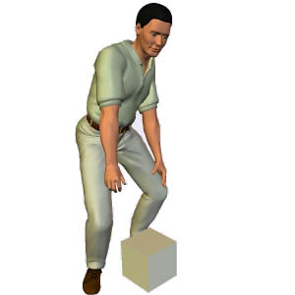
Correct Handling
Place the feet apart to give a balanced and stable base
Have the leading leg as far forward as possible

Slide 13
Unlock the knees
Bend the knees so that the hands when grasping the load are about level with the waist
But don’t over flex the knees
Keep the back straight to maintain the natural curves
Notes:
Bend the knees so that the hands when grasping the load are about level with the waist but don’t over flex the knees. If you repetitively keep the back straight and over bend the knees they will eventually stiffen up. Keep all muscles relaxed as tense muscles are more prone to injury.
Keep the back straight to maintain the natural curves and the shoulders level and facing the same direction as the hips.

Slide 14
Using the arms
Grip
  Palms up is stronger
  Hand holds not necessary the best way to lift
Elbows
  The arms are stronger when the elbows are closer to the body

Slide 15
Problems of Manual Handling
The task
The load
The working environment
Individual capacity
Handling aid and equipment
Work organisation factors

Slide 16
Task
Focus on what the person is doing
  Posture
  Reaching
  Working height
  Travel distance
  Pushing and pulling
  Sudden movement
  Seated or team lifting
  Work organisation
Notes:
The operator should adopt the correct position before attempting to move an object.

Slide 17
The Load
  Weight
  Shape
  Size
  Centre of Gravity
  Sudden movements
  Grasping and moving the load
  HSE Guidance
Notes:
Reducing the size of the load will make it easier to move – sometimes a large bulky item will be difficult to move even if it is very light. The size of the load should still allow the user to see where they are going and placing their feet.
Centre of gravity is one of the most important things when assessing how to lift or move a load. Once an individual picks up a load their centre of gravity is changed – therefore the heaviest or most bulky part of the load should be placed closest to the body if possible. Objects that may move of their own accord or that are flexible, such as bags of packing materials, should be carried or packed inside a container.

Slide 18
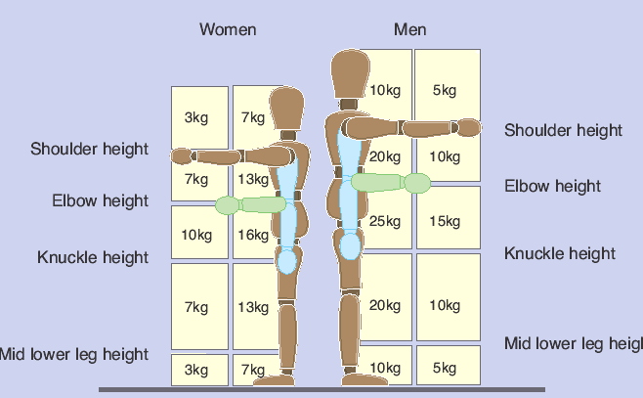
Guidance for load handling

Slide 19
Working Environment
  Space constraints
  Variation in level
  Floor
  Environmental factors
Notes:
Operators should have sufficient space around and above them to allow for suitable postures when moving loads. Awareness of variations in floor levels and surfaces and any doors that need to be opened etc on the route. Temperature ventilation humidity and lighting also need consideration as will any need to leave the building and be exposed to weather etc.

Slide 20
Individual Capacity
Individual characteristics affect the risk involved in the activity
  Gender incl pregnancy
  Age
  Disability
  Positive discrimination
  Health issues
Notes:
Operators should have sufficient space around and above them to allow for suitable postures when moving loads. Awareness of variations in floor levels and surfaces and any doors that need to be opened etc on the route. Temperature ventilation humidity and lighting also need consideration as will any need to leave the building and be exposed to weather etc.

Slide 21
Planning the lift
Stop and think
Place the feet
Good posture
Get a firm grip
Smooth movement – don’t jerk
Move the feet
Keep the load close to the body
Put the load down and readjust
Notes:
Stop and think – plan what your going to lift – can you use a trolley instead? Where are you going to put the load? Will you need to get someone to help you? Are there any obstructions in your way, if so move them before you try to lift. If you are carrying a long way, find somewhere to have a rest part way through.
Place the feet – the feet should be apart with one leg slightly forward to help you balance.
Good posture – don’t just bend at the waist, try to keep the back strong and lead with the head. Slightly bend the back, hips and knees.
Get a firm grip – make sure your hand holds are ok, clean etc
Smooth movement – don’t jerk as this makes the load harder to control
Move the feet
Keep the load close to the body - hold the load as close to you as possible, almost like a hug.
Put the load down and readjust
Don’t lift or handle more than can be easily managed – if you are in any doubt get help or advice.
Don’t twist the back or lean sideways while you are holding the load

Slide 22
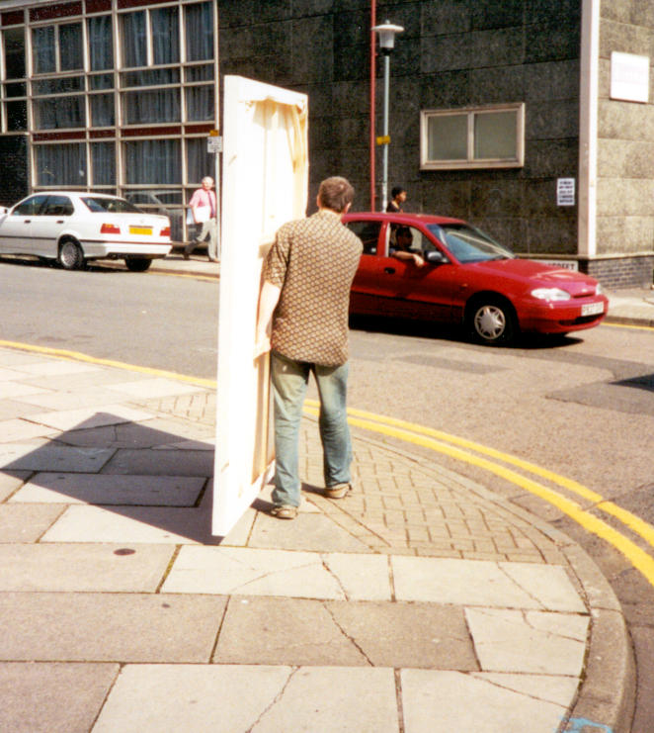

Slide 23
Ways to reduce the risk
Exercise is the best way to be fit for lifting and carrying
Abdomen provides natural support for the spine
Notes:
Govt recommends at least 3 x ½ hourly sessions of exercise per week
View abdomen as a closed box that can be used to support the spine, pull it all in and practice breathing with it held in this helps strength and so provides more support. Ladies, pelvic floor exercises – keep practicing them and this helps strengthen the support box of the abdomen

Slide 24
Thank you
Any questions? Contact H&S UK
© 2022 UK Health & Safety Officials.

